Slide 1





Partial Least Squares:
A Deep Space Odyssey
Artur Jordão
William Robson Schwartz (Advisor)

Slide 2
Introduction
Pattern recognition plays an important role in cognitive and decision-making tasks
Pattern recognition methods have led to a series of breakthroughs
Often surpassing human performance [Deng et al., 2009; Badia et al., 2020]
Deng et al. (2009). ImageNet: A Large-Scale Hierarchical Image Database. In CVPR.
Badia et al. (2020). Agent57: Outperforming the atari human benchmark. In ICML.
Notes:
PR desempenha um papel fundamental em tarefas cognitivas que envolvem tomadas de decisão.

Slide 3
Convolutional Networks
Visual pattern recognition models
Convolutional networks
Large architectures (large circles) lead to better results
0.92
NASNet
0.91
ResNet152
0.90
MobileNetV2
Predictive Ability (Accuracy)
ResNet50
0.89
MobileNetV1
Lower Better
0.88
Complexity
Higher Better
0.87
20.5
21
21.5
22
22.5
23
23.5
Computational Cost (Floating Point Operations)
Introduction
Notes:
Ambientes com recursos comp. Limitados.

Slide 4
Convolutional Networks
Pruning approaches
Locate and remove structures (i.e., filters or layers) from the architecture
Existing criteria for pruning convolutional networks are ineffective since the accuracy of the original (unpruned) network is degraded
Original, unpruned, Network
Pruning Neurons
Pruning Layers
Introduction
Notes:
Indicando que o critério que determina a importância dos neurônio

Slide 5
Convolutional Networks
Neural Architecture Search (NAS)
Automatically design efficient and accurate
Current strategies analyze a large set of possible candidate architectures
Require vast computational resources and take many days to process
Human-designed
Automatically designed
Introduction
Notes:
Modelar melhor os dados visuais.

Slide 6
Convolutional Networks
HyperNets approaches
Explore early and deep layers to improve data representation
HyperNets approaches insert time-consuming operations
Convolutional Network
Combination
Introduction

Slide 7


Dimensionality Reduction
Dimensionality reduction is able to yield discriminative representations besides reducing computational cost
Partial Least Squares (PLS) has presented remarkable results
Discriminative
Robust to sample size problem (singularity)
Operate as a feature selection method
Low-Dimensional Space
(Latent Space)
High-Dimensional Space
Dimensionality
Reduction
$$X∈ℝ^{3}$$
$$X′∈ℝ^{2}$$
Introduction

Slide 8
Dimensionality Reduction
Unfeasible for large datasets (e.g., ImageNet) since all the data need to be available in advance
Memory constraints
Incremental dimensionality reduction methods
Find the latent space using a single data sample at a time
Keep some properties of the traditional dimensionality reduction methods
Most incremental Partial Least Squares are computationally inefficient and do not preserve all the properties of PLS
Introduction

Slide 9
Hypotheses

Slide 10
Hypothesis
The importance of a structure composing the convolutional architecture can be effectively estimated using Partial Least Squares
Our central hypothesis is that Partial Least Squares learns the importance inherent to predictive ability of the network
Notes:
Falar da intuição por trás do PLS antes de iniciar a última hipótese

Slide 11
Hypothesis
The importance of a structure composing the convolutional architecture can be effectively estimated using Partial Least Squares
We can remove neurons and layers from convolutional networks to decrease the computational cost
Original, unpruned, Network
Network after Pruning
Notes:
Falar da intuição por trás do PLS antes de iniciar a última hipótese

Slide 12
Hypothesis
The importance of a structure composing the convolutional architecture can be effectively estimated using Partial Least Squares
We can insert structures to automatically design high-performance architectures
Automatically designed
Notes:
Tem que falar que vamos inserir estruturas permitindo desenvolver arquiteturas automaticamente.

Slide 13
Hypothesis
The importance of a structure composing the convolutional architecture can be effectively estimated using Partial Least Squares
We can combine multiple levels of representation to improve data representation
Convolutional Network
Combination
Notes:
Tem que flar que é combinar de forma eficiente

Slide 14


Hypothesis
It is possible to compute all components of PLS incrementally using simple algebraic decomposition
Low time complexity
Preserves the proprieties of PLS across all components
Low Dimensional Space
(Latent Space)
High Dimensional Space
Incremental PLS
$$X∈ℝ^{3}$$
$$X′∈ℝ^{2}$$

Slide 15
Summary
Theoretical Concepts
Pruning Approaches
Pruning Filters
Pruning Layers
Neural Architecture Search
HyperNet
Incremental Partial Least Squares

Slide 16
Theoretical Concepts

Slide 17
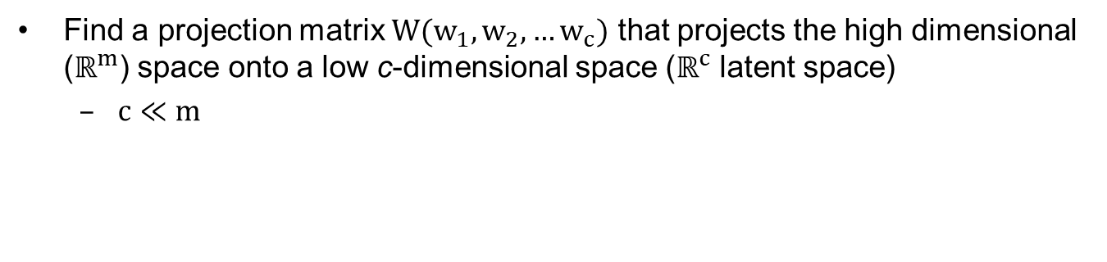


Partial Least Squares
Find a projection matrix $W(w_{1}, w_{2}, …w_{c})$ that projects the high dimensional ($ℝ^{m}$) space onto a low c-dimensional space ($ℝ^{c}$ latent space)
$c≪m$
PLS
$$X∈ℝ^{m}$$
$$X′∈ℝ^{c}$$
Theoretical Concepts
Notes:
C é um parametro

Slide 18
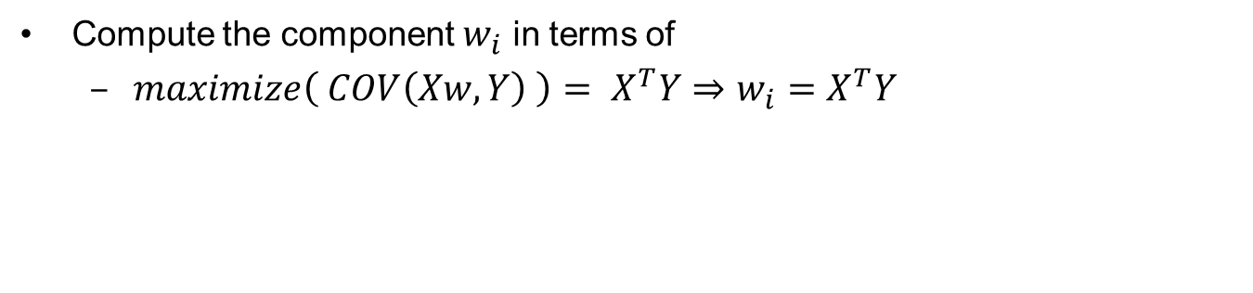
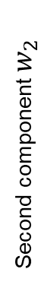

Partial Least Squares
Compute the component $w_{i}$ in terms of
$maximize\left( COV\left(Xw, Y\right) \right)= X^{T}Y⇒w_{i}=X^{T}Y$
Second component $w_{2}$
First component $w_{1}$
Theoretical Concepts
Notes:
Falar oq são os componentes de higher-order
Explicar com calma oq é X é o que é Y

Slide 19

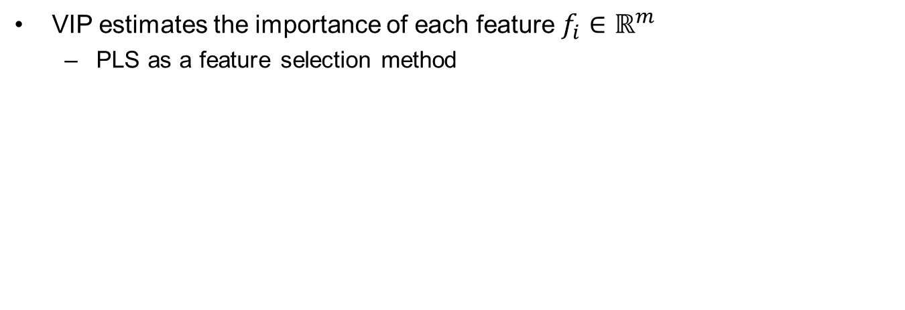
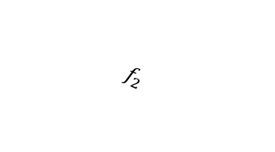



Variable Importance in Projection (VIP)
VIP estimates the importance of each feature $f_{i}∈ℝ^{m}$
PLS as a feature selection method
$$f_{m}$$
PLS
$$f_{2}$$
$$f_{1}$$
$$X∈ℝ^{m}$$
$$X′∈ℝ^{c}$$
Theoretical Concepts

Slide 20
Summary
Theoretical Concepts
Pruning Approaches
Pruning Filters
Pruning Layers
Neural Architecture Search
HyperNet
Incremental Partial Least Squares
Notes:
Para demonstrar parte da nossa hipóstese.

Slide 21
Pruning Filters

Slide 22
Problem Definition
Identify and remove (red dashed squares) neurons that preserve as much accuracy as possible
Original, unpruned, Network
Network after Pruning
Proposed Approach – Pruning Filters

Slide 23
Pruning Filters
Convolutional Network
Layer 1
Layer 2
Layer 3
Conv. Layer
Conv. Layer
Conv. Layer
Feature Space
(High Dimensional)
Feature Vector
Feature Vector
Proposed Approach – Pruning Filters
Notes:
Cada layer contém somente um filtro
Falar que é completamente automático da onde ele tira, pra ajudar a linkar com a questão ResNet50 ImageNet224x224

Slide 24
Overview
Repeat # Iterations
Filter
Representation
Dimensionality
Reduction (PLS)
Filter Importance
(VIP)
Prune and
Fine-Tune
Proposed Approach – Pruning Filters
Notes:
Onde a entrada do i+1...

Slide 25
Experiments Pruning Filters

Slide 26
Applications and Datasets
Activity Recognition
5 - 21 classes
Cross-validation
Face Verification
Two classes
Cross-validation
Image Classification
10 - 1,000 classes
Hold-out
Labeled Faces in the Wild (LFW)
ImageNet
Experimental Setup

Slide 27
Experimental Setup
Parameter Assessment
Validation set
Convolutional Networks
VGG16
ResNets
Computational Cost
Number of Floating Point Operations (FLOPs)
Statistical Test
Paired t-test using 95% confidence
Experimental Setup
Notes:
Explicar porque não rodar statistical tests on image classification. Enfatizar que isso é usado pra tudo

Slide 28
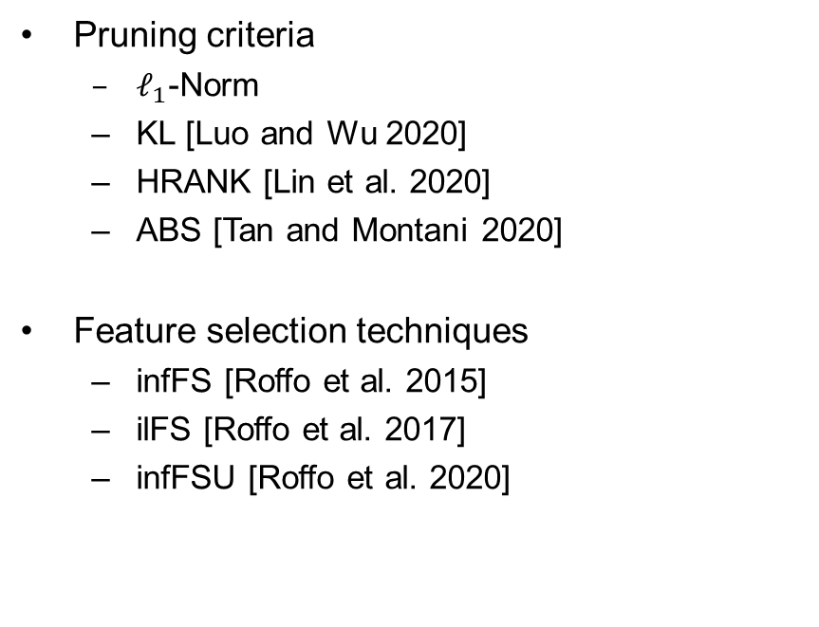
Comparison with other Pruning Criteria
Pruning criteria
$ℓ_{1}$-Norm
KL [Luo and Wu 2020]
HRANK [Lin et al. 2020]
ABS [Tan and Montani 2020]
Feature selection techniques
infFS [Roffo et al. 2015]
ilFS [Roffo et al. 2017]
infFSU [Roffo et al. 2020]
Pre-trained
Architecture
Pruning
Criteria
Prune and
Fine-Tune
Roffo et al. (2015). Infinite feature selection. In ICCV.
Roffo et al. (2017). Infinite latent feature selection: A probabilistic latent graph-based ranking approach. In ICCV.
Roffo et al. (2020). Infinite feature selection: a graph-based feature filtering approach. In PAMI.
Luo and Wu (2020). Neural network pruning with residual-connections and limited-data. In CVPR.
Lin et al. (2020). Hrank: Filter pruning using high-rank feature map. In CVPR.
Tan and Montani (2020). Dropnet: Reducing neural network complexity via iterative pruning. In ICML.
Experiments – Pruning Filters

Slide 29
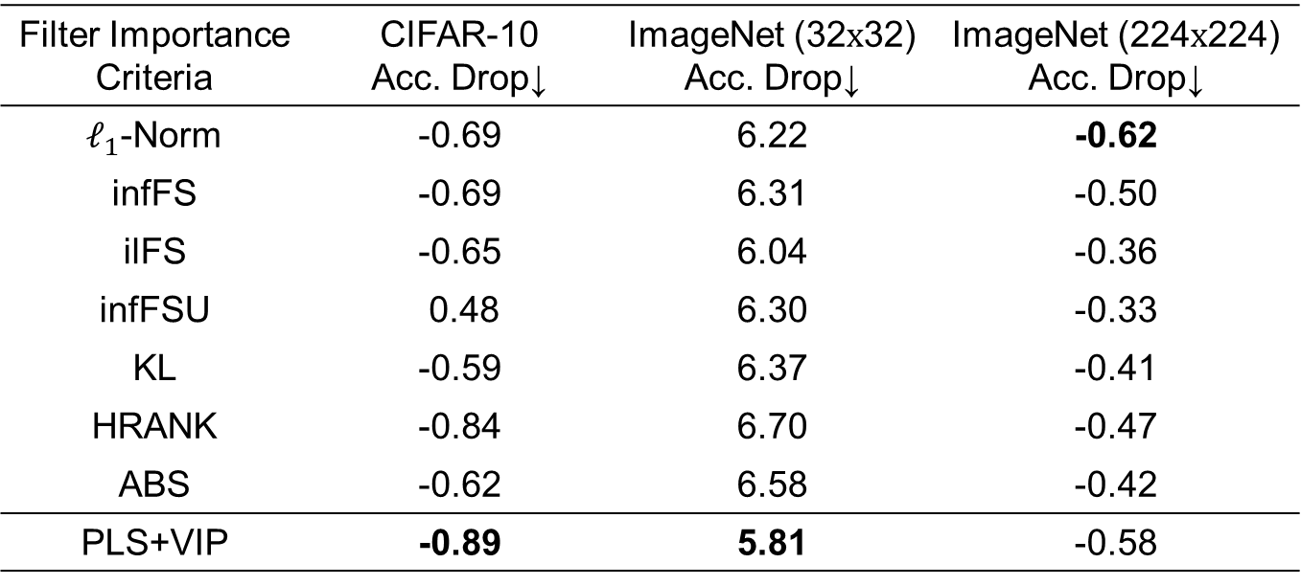
Comparison with other Pruning Criteria
VGG16
Filter Importance Criteria | CIFAR-10 Acc. Drop↓ | ImageNet (32$x$32) Acc. Drop↓ | ImageNet (224$x$224) Acc. Drop↓
$ℓ_{1}$-Norm | -0.69 | 6.22 | -0.62
infFS | -0.69 | 6.31 | -0.50
ilFS | -0.65 | 6.04 | -0.36
infFSU | 0.48 | 6.30 | -0.33
KL | -0.59 | 6.37 | -0.41
HRANK | -0.84 | 6.70 | -0.47
ABS | -0.62 | 6.58 | -0.42
PLS+VIP | -0.89 | 5.81 | -0.58
Experiments – Pruning Filters
Notes:
Descrever a tabela
Falar rapidamente qual a vantagem do PLS em relação a esses critérios.
Falar que aqui já mostramos que o nosso critério é bom pra representar os filtros.

Slide 30
Comparison with other Pruning Approaches
ResNet56 on CIFAR-10
3
Higher Better
He et al. [2018a]
He et al. [2020]
Chin et al. [2020]
Guo et al. [2020]
Lin et al. [2020]
Ours
2.5
2
Lower Better
1.5
Drop in Accuracy (p.p.)
1
0.5
0
-0.5
-1
50
55
60
65
70
75
FLOP Reduction (%)
He et al. (2018a). Soft filter pruning for accelerating deep convolutional neural networks. In CVPR.
He et al. (2020). Learning filter pruning criteria for deep convolutional neural networks acceleration. In CVPR
Chin et al. (2020). Towards efficient model compression via learned global ranking. In CVPR
Guo et al (2020). A unified framework for model compression. In CVPR.
Lin et al. (2020). Hrank: Filter pruning using high-rank feature map. In CVPR.
Experiments – Pruning Filters
Notes:
Falar que tal tendência se manteve para outras arquiteturas neste dataset.
Explicar oq é dominar outras soluções.
Specifically, one cannot obtain improvement in one metric without degrading the other metric

Slide 31
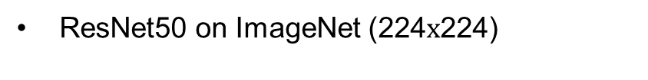
Comparison with other Pruning Approaches
ResNet50 on ImageNet (224$x$224)
3.5
Higher Better
He et al. [2019b]
Gou et al. [2020]
He et al. [2020]
Luo and Wu [2020]
Lin et al. [2020]
Ours
3
2.5
Lower Better
2
Drop in Accuracy (p.p.)
1.5
1
0.5
0
-0.5
40
45
50
55
60
65
70
75
80
FLOP Reduction (%)
He et al. (2019b). Filter pruning via geometric median for deep convolutional neural networks acceleration. In CVPR.
Guo et al (2020). A unified framework for model compression. In CVPR.
He et al. (2020). Learning filter pruning criteria for deep convolutional neural networks acceleration. In CVPR
Luo and Wu (2020). Neural network pruning with residual-connections and limited-data. In CVPR.
Lin et al. (2020). Hrank: Filter pruning using high-rank feature map. In CVPR.
Experiments – Pruning Filters
Notes:
Explicar que foi pq ele removeu filtros de camadas que tinham poucos flops.

Slide 32
Conclusions
We demonstrate that is possible to remove unimportant, or least important, filters by estimating their importance using PLS
Compared to existing criteria for determining filter importance, PLS achieves the lowest drop in accuracy
Compared to state-of-the-art pruning approaches, our strategy for removing filters achieves one of the best trade-offs between FLOP reduction and accuracy drop
Pruning Filters

Slide 33
Summary
Theoretical Concepts
Pruning Approaches
Pruning Filters
Pruning Layers
Neural Architecture Search
HyperNet
Incremental Partial Least Squares

Slide 34
Pruning Layers

Slide 35
Problem Definition
Identify and remove (red dashed rectangles) layers that preserve as much accuracy as possible
Conv. Layer
Conv. Layer
Conv. Layer
Proposed Approach – Pruning Layers

Slide 36
Pruning Layer
Conv. Layer
Conv. Layer
Conv. Layer
Conv. Layer
Conv. Layer
Conv. Layer
Conv. Layer
Conv. Layer
Conv. Layer
Proposed Approach – Pruning Layers
Notes:
Falar da questão da média

Slide 37
Overview
Repeat # Iterations
Layer (module)
Representation
Dimensionality
Reduction (PLS)
Layer Importance
(VIP)
Prune and
Fine-Tune
Proposed Approach – Pruning Layers

Slide 38
Experiments Pruning Layers

Slide 39
Comparison with other Pruning Criteria
Pruning criteria
KL [Luo and Wu 2020]
HRANK [Lin et al. 2020]
ABS [Tan and Montani 2020]
Feature selection techniques
infFS [Roffo et al. 2015]
ilFS [Roffo et al. 2017]
infFSU [Roffo et al. 2020]
Pre-trained
Architecture
Pruning
Criteria
Prune and
Fine-Tune
Roffo et al. (2015). Infinite feature selection. In ICCV.
Roffo et al. (2017). Infinite latent feature selection: A probabilistic latent graph-based ranking approach. In ICCV.
Roffo et al. (2020). Infinite feature selection: a graph-based feature filtering approach. In PAMI.
Luo and Wu (2020). Neural network pruning with residual-connections and limited-data. In CVPR.
Lin et al. (2020). Hrank: Filter pruning using high-rank feature map. In CVPR.
Tan and Montani (2020). Dropnet: Reducing neural network complexity via iterative pruning. In ICML.
Experiments – Pruning Layers
Notes:
Permite mensurar somente a influência...

Slide 40
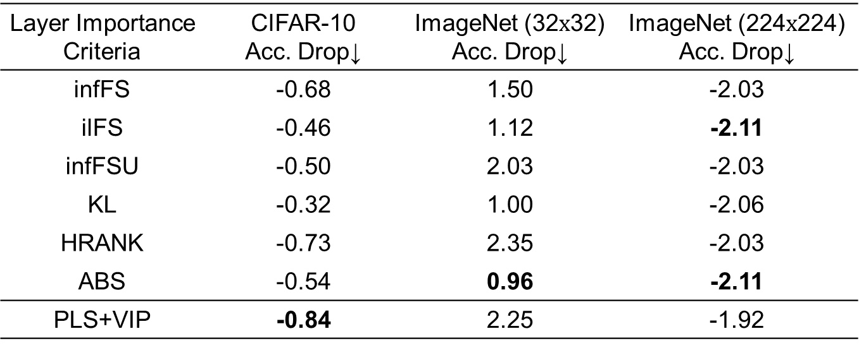
Comparison with other Pruning Criteria
ResNet56 (CIFAR and ImageNet 32$x$32) and ReNet50 (ImageNet 224$x$224)
Layer Importance Criteria | CIFAR-10 Acc. Drop↓ | ImageNet (32$x$32) Acc. Drop↓ | ImageNet (224$x$224) Acc. Drop↓
infFS | -0.68 | 1.50 | -2.03
ilFS | -0.46 | 1.12 | -2.11
infFSU | -0.50 | 2.03 | -2.03
KL | -0.32 | 1.00 | -2.06
HRANK | -0.73 | 2.35 | -2.03
ABS | -0.54 | 0.96 | -2.11
PLS+VIP | -0.84 | 2.25 | -1.92
Experiments – Pruning Layers
Notes:
Falar que aqui já mostramos que o nosso critério é bom pra representar os filtros

Slide 41
Comparison with other Pruning Approaches
ResNet110 on CIFAR-10
1.2
Higher Better
Veit et al. [2020]
Wu et al. [2018]
Huang et al. [2018a]
Ours
1
0.8
Lower Better
0.6
Drop in Accuracy (p.p.)
0.4
0.2
0
-0.2
-0.4
0
10
20
30
40
50
60
70
80
FLOP Reduction (%)
Veit et al. (2020). Convolutional networks with adaptive inference graphs. In IJCV.
Wu et al. (2018a). Blockdrop: Dynamic inference paths in residual networks. In CVPR.
Huang et al. (2018). Data-driven sparse structure selection for deep neural networks. In ECCV.
Experiments – Pruning Layers
Notes:
Falar que usamos somente 10% dos dados

Slide 42
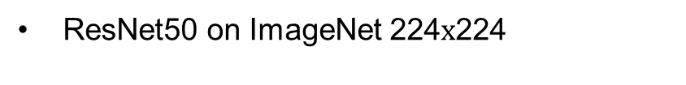
Comparison with other Pruning Approaches
ResNet50 on ImageNet 224$x$224
1
Higher Better
Wang et al. [2020a]
Huang et al. [2018]
Veit et al. [2020]
Ours
0.8
0.6
Lower Better
0.4
Drop in Accuracy (p.p.)
0.2
0
-0.2
10
15
20
25
30
35
40
45
50
FLOP Reduction (%)
Veit et al. (2020). Convolutional networks with adaptive inference graphs. In IJCV.
Wu et al. (2018a). Blockdrop: Dynamic inference paths in residual networks. In CVPR.
Huang et al. (2018). Data-driven sparse structure selection for deep neural networks. In ECCV.
Experiments – Pruning Layers
Notes:
Falar que usamos somente 10% dos dados

Slide 43
Conclusions
We demonstrate that is possible to remove unimportant, or least important, layers by estimating their importance using PLS
Compared to existing criteria for assigning layer importance, PLS achieves competitive results while being more efficient
Compared to state-of-the-art pruning approaches, our strategy for removing layers achieves the best trade-offs between FLOP reduction and accuracy drop
Pruning Layers

Slide 44
Summary
Theoretical Concepts
Pruning Approaches
Pruning Filters
Pruning Layers
Neural Architecture Search
HyperNet
Incremental Partial Least Squares

Slide 45
Neural Architecture Search

Slide 46
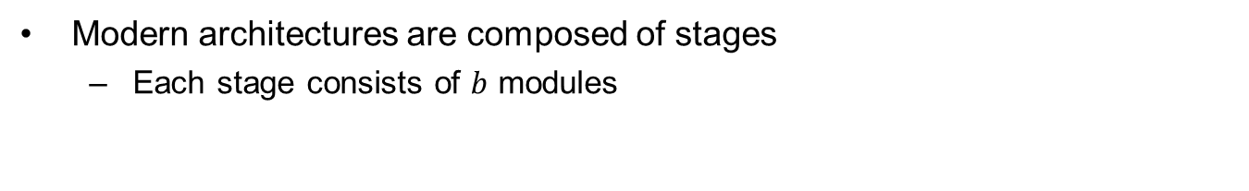
Problem Definition
Modern architectures are composed of stages
Each stage consists of $b$ modules
Stage 1
Stage 2
Stage 3
Module
Module
64
64
256
512
512
1024
Proposed Approach – NAS
Notes:
b = depth

Slide 47
Problem Definition
Stage 1
Stage 2
Stage 3
Human-designed
Architectures
Depth = 3
Depth = 3
Depth = 3
Stage 1
Stage 2
Stage 3
Proposed NAS
Depth = 3
Depth = 2
Depth = 4
Proposed Approach – NAS
Notes:
Human = ou é igual ou é setado empiricamente (regime tentativa e erro)
Concluir falando que o formato do módulo nos é dado.
Tem que falar a hipótese de que esses estágios não precisar ser do mesmo tamanho

Slide 48
Proposed Approach
Input
Architecture
Importance
0.87
Importance
0.72
Importance
0.92
Temporary
Architecture
Importance
0.93
Importance
0.68
Importance
0.94
Candidate
Architecture 1
Proposed Approach – NAS
Notes:
Falar que a célula nos é dado.
Beneficios aqui representados pela importância.
Aqui precisa ter a questão de gerar poucos modelos. Talvez explicar a complexidade

Slide 49
Proposed Approach
Stage 1
Stage 2
Stage 3
Proposed Approach – NAS
Notes:
Falar que existem garantias empíricas que a ultima layer representa tudo

Slide 50
Overview
Repeat # Iterations
Initial
Architecture
Temporary
Architecture
Compute/Compare
Importance
Candidate Architecture
Proposed Approach – NAS

Slide 51
Experiments Neural Architecture Search

Slide 52
Importance Criteria
CIFAR-10
Criterion | Iteration (ith Candidate Arch.)
 | 1 | 2 | 3 | 4 | 5
infFS [Roffo et al. 2015] | 91.59 | 92.09 | 92.02 | 92.36 | 92.45
ilFS [Roffo et al. 2017] | 91.94 | 92.06 | 92.10 | 92.08 | 92.52
infFSU [Roffo et al. 2020] | 90.42 | 92.26 | 91.95 | 92.41 | 92.64
PLS+VIP | 92.03 | 92.38 | 92.62 | 92.53 | 92.58
Roffo et al. (2015). Infinite feature selection. In ICCV.
Roffo et al. (2017). Infinite latent feature selection: A probabilistic latent graph-based ranking approach. In ICCV.
Roffo et al. (2020). Infinite feature selection: a graph-based feature filtering approach. In PAMI.
Experiments – NAS

Slide 53
Comparison with human-designed architectures
CIFAR-10
* indicates human-designed architectures
Architecture | Depth | Param. ↓ (Million) | FLOP↓ (Million) | Accuracy↑
ResNet44* | 44 | 0.66 | 97 | 92.83
Ours (it=1) | 43 | 0.60 | 92 | 93.38
ResNet56* | 56 | 0.86 | 125 | 93.03
Ours (it=3) | 59 | 0.69 | 130 | 93.36
ResNet110* | 110 | 1.7 | 253 | 93.57
Ours (i=5) | 67 | 0.88 | 149 | 94.27
Experiments – NAS

Slide 54
Comparison with state-of-the-art NAS
CIFAR-10
Model | Evaluated↓ Models | GPUs ↓ | Param.↓ (Million) | Accuracy↑
Zoph et al. [2018] | 20, 000 | 800 | 2.5 | 94.51
Real et al. [2017] | 1, 000 | 250 | 5.4 | 94.60
Dong and Yang [2019] | 240 | 1 | 2.6 | 96.25
Yang et al. [2020b] | 128 | 1 | 3.6 | 97.38
Jin et al. [2019] | 60 | 1 | --- | 88.56
Ours (it=5) | 11 | 1 | 2.3 | 94.74
Zoph et al. (2018). Learning transferable architectures for scalable image recognition. In CVPR.
Real et al. (2017). Large-scale evolution of image classifiers. In ICML.
Dong and Yang et al. (2019). Searching for a robust neural architecture in four GPU hours. In CVPR.
Yang et al. (2020b). CARS: continuous evolution for efficient neural architecture search. In CVPR.
Jin et al. (2019). Auto-keras: An efficient neural architecture search system. In SIGKDD.
Experiments – NAS
Notes:
É bom faalr que estamos usando outro módulo aqui

Slide 55
Conclusions
We demonstrate that it is possible to design high-performance convolutional architectures by inserting layers based on their importance
Layer importance is assigned by PLS
Compared to NAS strategies, our method is extremely more efficient, as it evaluates one order of magnitude fewer models and discovers architectures on par with the state of the art
NAS

Slide 56
Summary
Theoretical Concepts
Pruning Approaches
Pruning Filters
Pruning Layers
Neural Architecture Search
HyperNet
Incremental Partial Least Squares

Slide 57
HyperNet Approach

Slide 58
Problem Definition
Convolutional Network
Combination
Proposed Approach – Latent HyperNet

Slide 59



Proposed Approach
Convolutional Network
$$X_{1}W_{1}$$
$$X_{2}W_{2}$$
$$X_{3}W_{3}$$
Latent HyperNet
(LHN)
Combination
Proposed Approach – Latent HyperNet
Notes:
Falar que é o mesmo classificador

Slide 60
Experiments Latent HyperNet

Slide 61
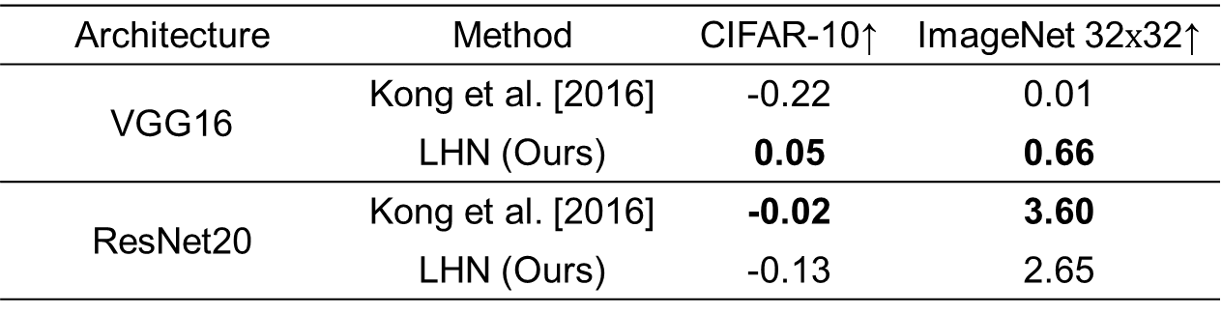
Improvements
Improvement in accuracy
Architecture | Method | CIFAR-10↑ | ImageNet 32$x$32↑
VGG16 | Kong et al. [2016] | -0.22 | 0.01
 | LHN (Ours) | 0.05 | 0.66
ResNet20 | Kong et al. [2016] | -0.02 | 3.60
 | LHN (Ours) | -0.13 | 2.65
Kong et al. (2016). Hypernet: Towards accurate region proposal generation and joint object detection. In CVPR.
Experiments – Latent HyperNet
Notes:
Não deu pra rodar a HyperNet Kong et al.
Falar da arquitetura que impede
Os improvements Estatisticamente superiores.

Slide 62
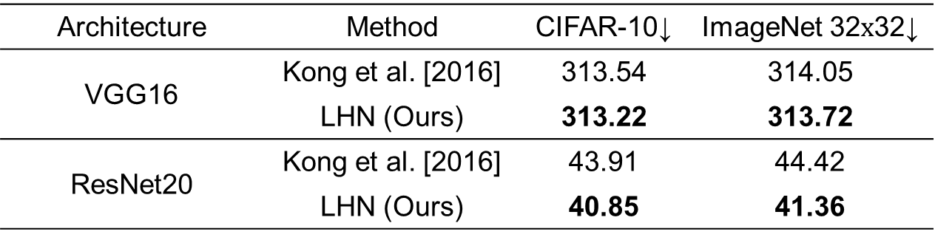
Computational Cost
Floating Point Operations
Million
Architecture | Method | CIFAR-10↓ | ImageNet 32$x$32↓
VGG16 | Kong et al. [2016] | 313.54 | 314.05
 | LHN (Ours) | 313.22 | 313.72
ResNet20 | Kong et al. [2016] | 43.91 | 44.42
 | LHN (Ours) | 40.85 | 41.36
Kong et al. (2016). Hypernet: Towards accurate region proposal generation and joint object detection. In CVPR.
Experiments – Latent HyperNet

Slide 63
Conclusions
We demonstrate that an efficient yet effective way of combining multiple levels of features is to project them on the latent space of PLS
Compared to time-consuming operations, we demonstrate that the PLS projection enhances data representation at negligible additional cost
Latent HyperNet
Notes:
No ultimo bullet enfatizar tipo o problema do baseline, que como ele modificou muito a rede ele não convergiu

Slide 64
Summary
Theoretical Concepts
Pruning Approaches
Pruning Filters
Pruning Layers
Neural Architecture Search
HyperNet
Incremental Partial Least Squares

Slide 65
Incremental PLS Approach

Slide 66
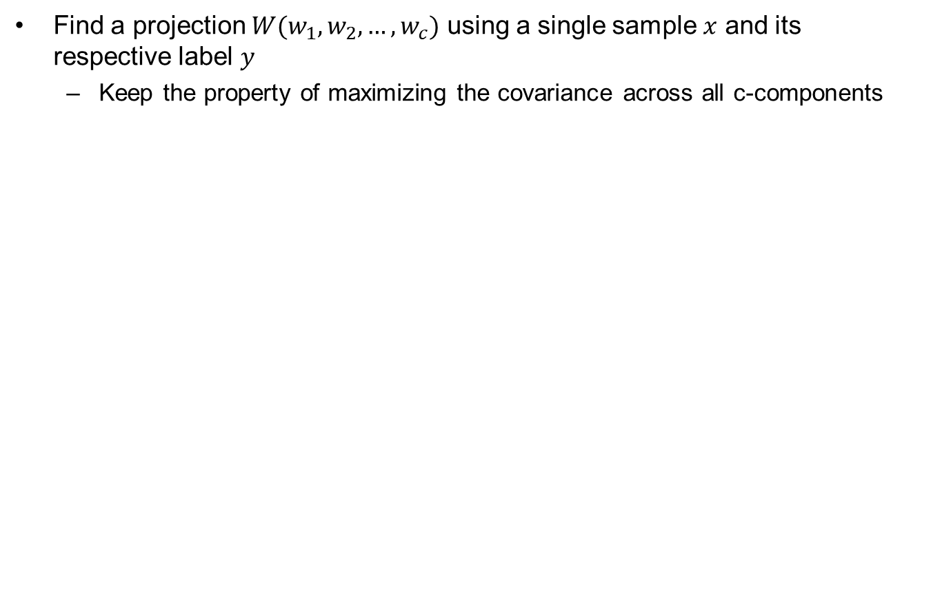

Problem Definition
Find a projection $W(w_{1}, w_{2},…, w_{c})$ using a single sample $x$ and its respective label $y$
Keep the property of maximizing the covariance across all c-components
($XW$)
$$X∈ℝ^{m}$$
$$X′∈ℝ^{c}$$
Proposed Approach – CIPLS
Notes:
Enfatizar o covariance-free

Slide 67
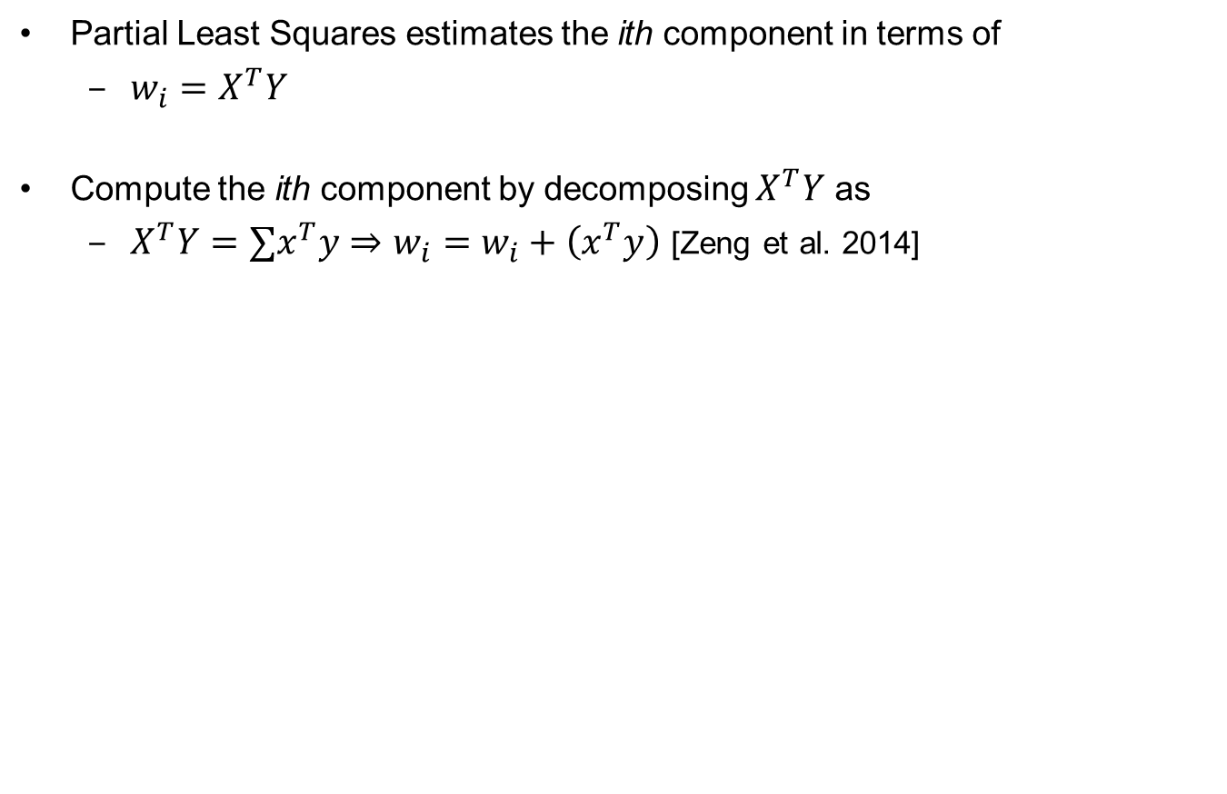
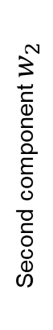

Proposed Approach
Partial Least Squares estimates the ith component in terms of
$w_{i}=X^{T}Y$
Compute the ith component by decomposing $X^{T}Y$ as
$X^{T}Y=∑x^{T}y⇒w_{i}=w_{i}+\left(x^{T}y\right)$ [Zeng et al. 2014]
Second component $w_{2}$
First component $w_{1}$
Zeng et al. (2014). Incremental Partial Least Squares Analysis of Big Streaming Data. In Pattern Recognition.
Proposed Approach – CIPLS
Notes:
Enfatizar o que covariance-free significa

Slide 68
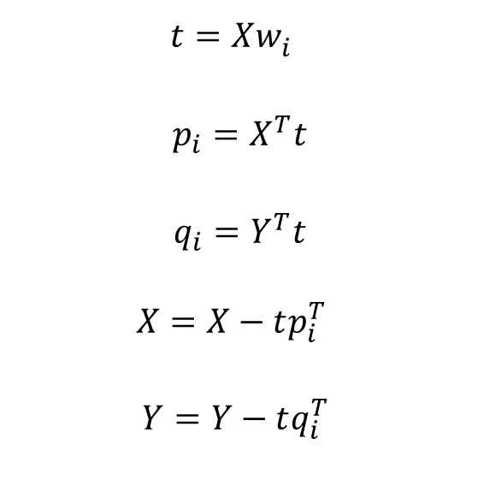
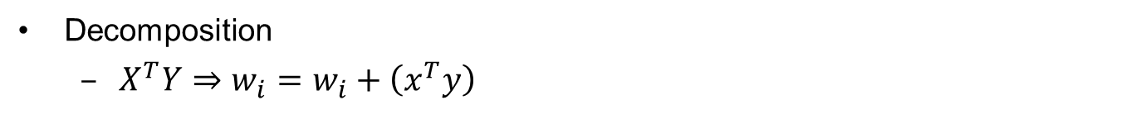
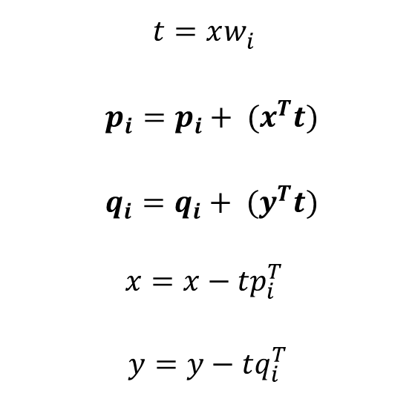
Proposed Approach
Decomposition
$X^{T}Y⇒w_{i}=w_{i}+\left(x^{T}y\right)$
Traditional PLS deflation
Proposed Deflation
$t=Xw_{i}^{}$
$p_{i}=X^{T}t$
$q_{i}=Y^{T}t$
$$X=X−tp_{i}^{T}$$
$$Y=Y−tq_{i}^{T}$$
Single Sample Projection
$t=xw_{i}^{}$
$p_{i}=p_{i}+ {(x}^{T}t)$
$q_{i}=q_{i}+ {(y}^{T}t)$
$$x=x−tp_{i}^{T}$$
$$y=y−tq_{i}^{T}$$
Decomposition
Decomposition
Single Sample Deflation
Single Label Deflation
Proposed Approach – CIPLS
Notes:
Enfatizar o covariance-free

Slide 69
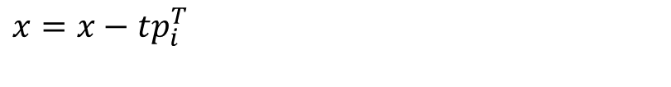
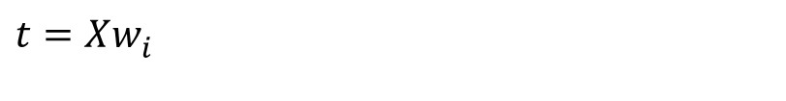

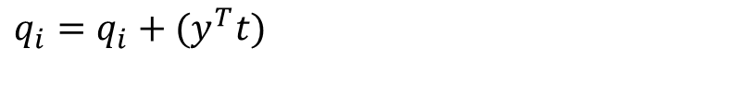
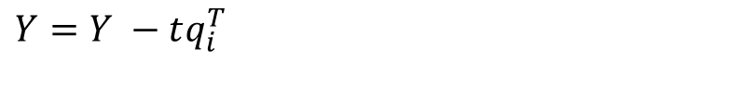
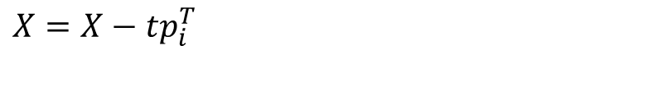
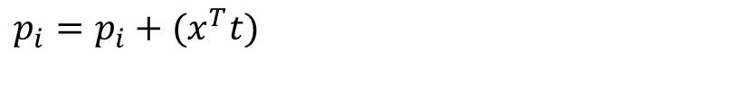
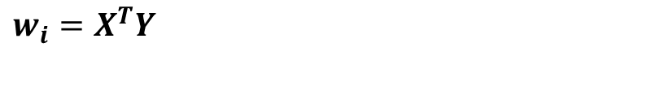
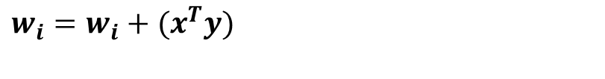
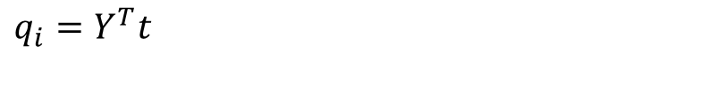
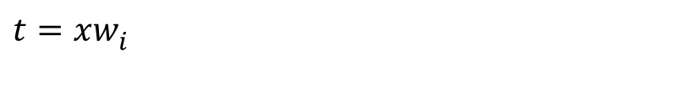
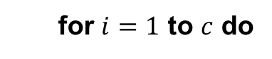

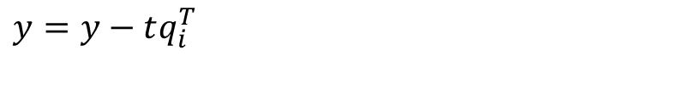
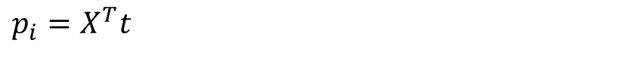
Overview
CIPLS Algorithm
PLS Algorithm
Foreach $x∈X and y∈Y$ do
for $i=1$ to $c$ do
for $i=1$ to $c$ do
$$w_{i}=w_{i}+(x^{T}y)$$
$$w_{i}=X^{T}Y$$
$$t=xw_{i}^{}$$
$$t=Xw_{i}^{}$$
$$p_{i}=p_{i}+(x^{T}t)$$
$$p_{i}=X^{T}t$$
$$q_{i}=q_{i}+(y^{T}t)$$
$$q_{i}=Y^{T}t$$
$$x=x−tp_{i}^{T}$$
$$X=X−tp_{i}^{T}$$
$$y=y−tq_{i}^{T}$$
$$Y=Y −tq_{i}^{T}$$
end
end
end
Proposed Approach – CIPLS

Slide 70
Experiments CIPLS

Slide 71
Comparison with other Incremental Methods
Face verification - Labeled Faces in the Wild (LFW)
Method | Accuracy↑ | Difference to PLS↓
SGDPLS [Arora et al., 2016] | 90.60 [89.95 91.24] | 1.87
IPLS [Zeng and Li, 2014] | 90.30 [89.60 90.99] | 2.17
PLS | 92.47 [91.87 93.05] | ---
CIPLS (Ours) | 91.78 [91.08 92.47] | 0.69
Method | Accuracy↑ | Difference to PLS↓
CCIPCA [Weng et al., 2003] | 89.87 [89.17 90.55] | ---
SGDPLS [Arora et al., 2016] | 90.60 [89.95 91.24] | 1.87
IPLS [Zeng and Li, 2014] | 90.30 [89.60 90.99] | 2.17
PLS | 92.47 [91.87 93.05] | 0.00
CIPLS (Ours) | 91.78 [91.08 92.47] | 0.69
Weng et al. (2003). Candid covariance-free incremental principal component analysis. In PAMI.
Zeng et al. (2014). Incremental partial least squares analysis of big streaming data. Pattern Recognition.
Arora et al (2016). Stochastic optimization for multiview representation learning using partial least squares. In ICML.
Zeng et al. (2014). Incremental partial least squares analysis of big streaming data. Pattern Recognition.
Arora et al (2016). Stochastic optimization for multiview representation learning using partial least squares. In ICML.
Experiments – CIPLS
Notes:
Estatisticamente equivalente
Explicar pq o CCIPCA esta na comparação.

Slide 72
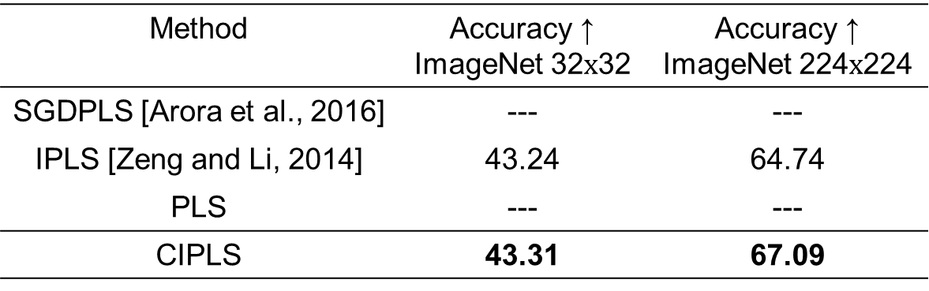
Comparison with other Incremental Methods
Image classification - ImageNet
Method | Accuracy ↑ ImageNet 32$x$32 | Accuracy ↑ ImageNet 224$x$224
SGDPLS [Arora et al., 2016] | --- | ---
IPLS [Zeng and Li, 2014] | 43.24 | 64.74
PLS | --- | ---
CIPLS | 43.31 | 67.09
Zeng et al. Incremental partial least squares analysis of big streaming data. Pattern Recognition, 2014.
Arora et al. Stochastic optimization for multiview representation learning using partial least squares. In ICML. 2016.
Experiments – CIPLS

Slide 73
Computational Cost
Time (in seconds) for estimation the projection matrix
0.015
0.01
Time (seconds)
0.005
0
SGDPLS
IPLS
CCIPCA
CIPLS (Ours)
Experiments – CIPLS
Notes:
Aqui é erro então menor melhor

Slide 74
Conclusions
We show that it is possible to compute all components of PLS incrementally using simple algebraic decomposition
Preserves all the properties of PLS across all components
Computationally efficient and low time complexity
Our CIPLS is the most accurate and fastest incremental PLS
CIPLS

Slide 75
Publications
Journal Papers
Jordao, A., Yamada, F., and Schwartz, W. R. Deep Network Compression based on Partial Least Squares. Neurocomputing, 2020
Jordao, A., Lie, M., and Schwartz, W. R. Discriminative Layer Pruning for Convolutional Neural Networks. Journal of Selected Topics in Signal Processing, 2020

Slide 76
Publications
Conference Papers
Jordao, A., Kloss, R. B., and Schwartz, W. R. Latent hypernet: Exploring the layers of Convolutional Neural Networks. In International Joint Conference on Neural Networks (IJCNN), 2018
Jordao, A., Kloss, R., Yamada, F., and Schwartz, W. R. Pruning Deep Neural Networks using Partial Least Squares. British Machine Vision Conference (BMVC) Workshops: Embedded AI for Real-Time Machine Vision, 2019
Jordao, A., Lie, M., Yamada, F., and Schwartz, W. R. Stage-Wise Neural Architecture Search. International Conference on Pattern Recognition (ICPR). Accepted for publication, 2020
Jordao, A., Lie, M., de Melo, V. H. C., and Schwartz, W. R. Covariance-free partial least squares: An Incremental Dimensionality Reduction Method. Winter Conference on Applications of Computer Vision (WACV). Accepted for publication, 2021

Slide 77


Acknowledgments

Slide 78




Codes
Code is available at:
https://github.com/arturjordao
Latent HyperNet
Pruning Filters
Pruning Layers
CIPLS

Slide 79
Additional Slides

Slide 80
Thesis Statement
The importance of structures (neurons or layers) composing a convolutional network can be effectively estimated with Partial Least Squares, which in turn can be computed incrementally without degrading its discriminative information. With the estimation of this importance, it is possible to obtain high-performance convolutional networks by removing, inserting or combining structures

Slide 81
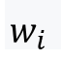
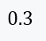
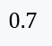
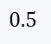
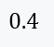
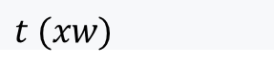
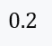
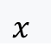
Projection
High-Dimensional Sample
$$x$$
$$0.7$$
$$0.2$$
$$0.4$$
$$0.5$$
$$0.3$$
$$w_{i}$$
$$t (xw)$$
Projected Sample

Slide 82
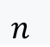
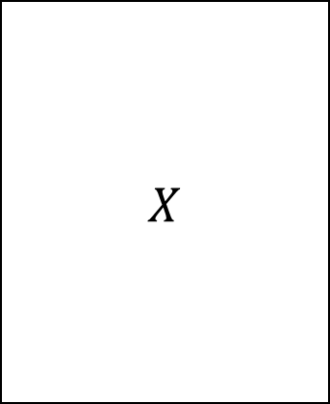
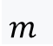
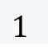
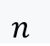
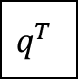


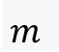




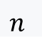

Partial Least Squares
$$m$$
$$1$$
$$1$$
$$X$$
$$t$$
$$Y$$
$$n$$
$$p^{T}$$
$$n$$
$$n$$
$$m$$
$$1$$
$$q^{T}$$
$$1$$
$$1$$

Slide 83
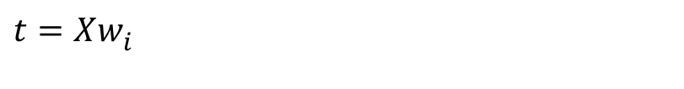
















Partial Least Squares
PLS1 Algorithm
PLS2 Algorithm
for $i=1$ to $c$ do
for $i=1$ to $c$ do
$$w_{i}=X^{T}Y$$
$$initialize u∈R^{nx1}$$
$$Repeat until convergence$$
$$t=Xw_{i}^{}$$
$$w_{i}=X^{T}u$$
$$p_{i}=X^{T}t$$
$$t=Xw_{i}^{}$$
$$q_{i}=Y^{T}t$$
$$q_{i}=Y^{T}t$$
$$X=X−tp_{i}^{T}$$
$$u=Yq_{i}$$
$$Y=Y −tq_{i}^{T}$$
end
$$p_{i}=X^{T}t$$
end
$$X=X−tp_{i}^{T}$$
$$Y=Y −tq_{i}^{T}$$
end
Notes:
Note, if Y has only 1 column, this reduces to PLS1 (q becomes 1, u becomes y)

Slide 84

Variable Importance in Projection
$$f_{j}=\sqrt{m\sum_{i=1}^{c}{SS_{i}(w_{ij}/{‖w_{i}‖}^{2})/\sum_{i=1}^{c}{SS_{i}}}}$$
$$SS_{i}=q_{i}^{2}t_{i}^{T}t_{i}$$
Notes:
Q^2 é a estatística para as features; indicar a importância de uma feature para um certo component
T^2 é a estatística para as samples; indica quão bem o objeto fit o modelo

Slide 85




PLS vs. CCA
$$corr\left(X^{i}, Y^{i}\right)=\frac{cov (X^{i}, Y^{i})}{var\left(X^{i}\right)∗var(Y^{i})}$$
$$f_{2}$$
$$cov\left(X^{i}, Y^{i}\right)=var\left(X^{i}\right)∗var\left(Y^{i}\right)∗corr(X^{i},Y^{i})$$
$$f_{1}$$

Slide 86

Benchmarks

Slide 87
VGG16
3x3 filters
VGG16 Architecture
64
/2
/2
/2
/2
/2
64
128
128
256
256
256
512
512
512
512
512
512
4096 (FC)x2
1000 (FC)

Slide 88


PLS GPU
Fully Connected Layer
PLS as Layer
W
(projection matrix)
First component
Second component
$$f\left(x\right)=xW+b$$
$$f\left(x\right)=xW^{}$$

Slide 89


Loss Landscape
$θ+(i∗α)+(j∗β)$
$θ$ network parameters
$α, β$ random distributions
Loss
i = 0
j = 0

Slide 90
Computational Time
8%
8%
24%
60%

Slide 91
Pruning Approach Additional Slides

Slide 92
NAS Additional Slides

Slide 93
Weight Transfer
Human-designed
Architectures
Candidate
Architecture
Notes:
Falar da intuição por trás do PLS antes de iniciar a última hipótese

Slide 94
Latent HyperNet Additional Slides

Slide 95
Baseline
Convolutional Network
Convolution
Activation
Pooling
Convolution
Activation
Pooling
Convolution
Activation
Pooling
Convolution
Convolution
Convolution
19
4
39
HyperNet
Kong et al. Hypernet: Towards accurate region proposal generation and joint object detection. In CVPR, 2016.

Slide 96



HyperNet
Original Image
Early Layer
Deep Layer
Notes:
Falar da intuição por trás do PLS antes de iniciar a última hipótese

Slide 97
Incremental PLS Additional Slides

Slide 98






IPLS Overview
Compute the component $w_{i}$ in terms of
$maximize\left(cov\left(Xw, Y\right)\right)= X^{T}Y⇒w_{i}=X^{T}Y$
$X$ and its respective $Y$ are not in memory in advance
Decomposition
$X^{T}Y=∑{(x}_{n}y_{n})$
$w_{i}=w_{i}+(x_{n}y_{n})$
[11]
IPLS Algorithm
foreach${ x}_{n}∈X and{ y}_{n}∈Y$ do
$$w_{0}={\overline{x}}_{n}y_{n}+w_{0\left(n−1\right)}$$
[12]
$$CCIPCA(\overline{x})$$
for $i=2$ to $c−1$ do
$$w_{i}={C^{i−1}w_{0}}_{}$$
end
end
[11] Zeng et al. Incremental partial least squares analysis of big streaming data. Pattern Recognition, 2014.
[12] Weng et al. Candid covariance-free incremental principal component analysis. In PAMI, 2003.
Related Work – Incremental PLS
Notes:
reconstruct the approximate covariance matrix using a few PCA principal components, which can be computed efficiently with the CCIPCA algorithm

Slide 99




SGDPLS Overview
SGDPLS Algorithm
foreach${ x}_{n}∈X and{ y}_{n}∈Y$ do
for $ep=1$ to $Epochs$ do
$$W_{n}=α{(x}_{n}y_{n})β_{n−1}$$
$$β_{n}=α\left(y_{n}x_{n}\right)W_{n−1}$$
end
end

Slide 100







CCIPCA Overview
CCIPCA Algorithm
foreach${ x}_{n}∈X and{ y}_{n}∈Y$ do
$$k=min⁡(n,L)$$
for $i=1$ to $k$ do
$$λ=\frac{n−1−l}{n}$$
$$θ=\frac{n+l}{n}$$
$$w_{i}=λw_{i}+θx_{n}{(x}_{n}^{T}w_{i})$$
$$x_{n}={x_{n}− (x}_{n}^{T}w_{i})w_{i}$$
end
end

Slide 101
Higher-order Components
PLS
SGDPLS
IPLS
CIPLS
Notes:
Falar oq são os eixos X e Y
X p.p w.r.t. SGDPLS
Y p.p. w.r.t IPLS

Slide 102


Introduction
Pattern recognition methods have led to a series of breakthroughs
Improvement in data representation (features)
Learn features from raw data (convolutional networks)
Transformations on the pre-computed features (dimensionality reduction)
2015
Deep Learning
Integral Features
2001
≈
2005
HOG Features
Notes:
Falar que pattern reconition é importante porque queremos automatizar as coisas....
discovering accurate and efficient data representations

